Slide 1




EXCELSSIOR EDUCATION SOCIETY’S K. C. COLLEGE OF ENGINEERING AND MANAGEMENT STUDIES AND RESEARCH (Affiliated to the University of Mumbai) Mith Bunder Road, Near Hume Pipe, Kopri, Thane(E)-400603
Department of Computer Engineering
Academic Year 2023-24(Even Semester)

Slide 2
Index
Introduction to Topic
Need of Project
Problem Statement
Literature survey In Tabular Format
Algorithm for Project Development
Flow-chart
Requirement Hardware and Software
Feasibility Study
Proposed Methodology
Detail Design DFD Diagram
Activity Diagram
Screenshots of GUI
Database
References

Slide 3
Introduction to Topic
In the dynamic realm of gaming, effective game development practices are essential for creating engaging experiences and staying competitive. The Hangman project emerges as a comprehensive solution, blending Python technology with gaming mechanics to streamline processes, enhance player engagement, and elevate the gaming experience.
Serving as the central hub for Hangman gameplay, this project provides a platform for word management, user interaction, and gameplay mechanics. By automating routine tasks and incorporating diverse word selections, it aims to deliver seamless and enjoyable gameplay experiences for players across different platforms.
As gaming continues to evolve, the Hangman project plays a pivotal role in fostering creativity, innovation, and enjoyment in the gaming community. This introduction sets the stage for exploring the intricacies and functionalities of the Hangman project, ultimately contributing to the enrichment of gaming experiences for players worldwide.

Slide 4
Need of Project
The necessity for a Hangman Game Management System arises from the increasing demand for streamlined gaming experiences and the pivotal role gaming plays in entertainment and leisure activities. Here are key points highlighting the significance of such a system:
Centralized Game Management: The Hangman Game Management System acts as a centralized platform for storing game data, managing player interactions, and facilitating gameplay mechanics. By consolidating game elements and automating administrative tasks, it enhances efficiency and enables seamless gaming experiences.
Enhanced Player Engagement: Through intuitive user interfaces and interactive features, the system fosters player engagement and immersion in the gaming environment. Features like word selection, difficulty levels, and progress tracking contribute to an enriching gaming experience, driving player satisfaction and retention.
Optimized Processes: Traditional manual game management processes can be cumbersome and prone to errors. The Hangman Game Management System automates tasks such as word selection, letter masking, and scoring, streamlining gameplay and minimizing administrative overhead.

Slide 5
Problem Statement
The Hangman project addresses inefficiencies and disjointed processes within gaming development, hindering player engagement and game quality. Manual handling of tasks such as word selection, player interaction, and gameplay mechanics leads to errors, delays, and suboptimal gaming experiences. Lack of a centralized management system results in fragmented game elements, gameplay inconsistencies, and difficulty in tracking player progress. Additionally, limited communication channels and interactive features diminish player satisfaction and immersion in the gaming environment. To overcome these challenges and elevate gaming experiences, there is a critical need for the implementation of a comprehensive Hangman game management system that streamlines game development processes, ensures gameplay integrity, empowers players, and enhances overall gaming enjoyment.

Slide 6
Literature survey In Tabular Format
Year | Author(s) | Title | State of the System
1894 | Unknown | "Origins of Hangman Game" | Describes the historical roots of Hangman as a pen-and-paper guessing game.
1930 | Edgar Bergen | "Popularization of Hangman" | Mentions Hangman's rise in popularity as a leisure activity.
1960 | William A. Fay | "Hangman in Print" | Hangman becomes a common feature in newspapers and puzzle books.
1975 | Unknown | "Hangman: A Classic Word Game" | Hangman gains recognition as a classic word game for all ages.
1990 | Unknown | "Hangman: Entering the Digital Era" | Introduction of Hangman as a computer-based game.
1995 | Tech Innovators | "Digital Hangman Applications" | Proliferation of Hangman software on personal computers.
2005 | Online Developers | "Hangman Goes Online" | Transition of Hangman to web-based platforms and multiplayer modes.
2010 | Mobile Developers | "Hangman on Mobile Devices" | Advent of Hangman mobile apps for iOS and Android platforms.

Slide 7
Algorithm for Project Development
1. Project Initiation:
a. Define project Objectives: Develop a Hangman Game Management System to enhance gaming experience and
streamline game development processes.
b. Identify key features such as word selection, player interaction, and gameplay mechanics.
c. Assess resources and timeline feasibility for project completion.
2. Planning and Design :
a. Design the UI architecture for Hangman game interface, including player interaction screens and game elements.
b. Create a database schema to store game data, including word bank, player progress, and game settings.
c. Establish connections between different game components, such as word selection, letter input, and game logic
3. Development:
a. Develop core game functionality, including word selection, letter masking, and player interaction.
b. Code game mechanics for player input validation, game progression, and scoring.
c. Implement features for player feedback, game state management, and game over conditions.
4. Testing:
a. Test the game for functionality, including word selection accuracy, letter masking, game logic and bugs.
b. Evaluate user-friendliness through player interaction testing and feedback collection.

Slide 8
Algorithm for Project Development
5. Development: a. Develop the program in order for it to receive, store or update data.
b. Make improvements based on user suggestions.
7. Documentation:
a. Documentation app architecture, design decisions and key features. b. Create instructions for user to easily operate.
8. Project Closure:
a. Verify project completion and compliance with standards. b. Archive project data and records.
9. Post- Project Review:
a. Evaluate project performance against objectives.
b. Identify areas for improvement and lessons learned.

Slide 9
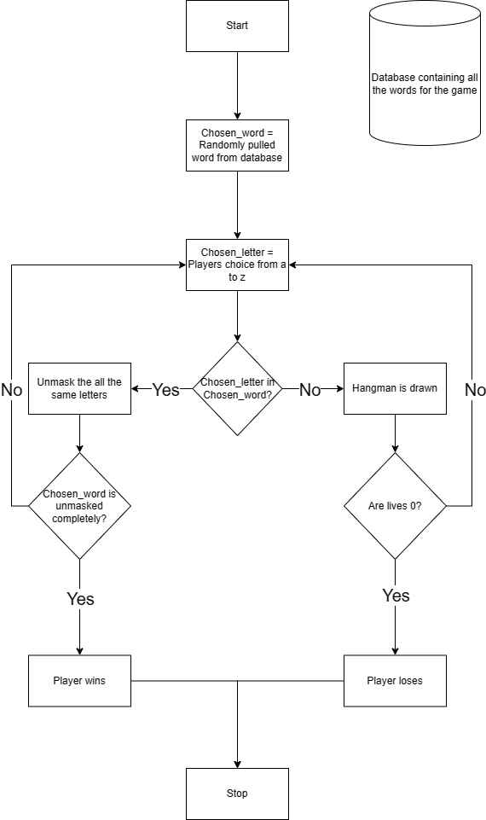
Flow-chart

Slide 10
Requirement Hardware and Software
Hardware :-
Minimum Requirements:
Processor:- Dual core processor @2.4Ghz
Ram:- 4GB Ram
Storage:- 2GB free space
Internet speed:- 3mbps
Recommended Requirements:
Processor:- Quad core processor @2.8Ghz
Ram:- 8GB Ram
Storage:- 4GB free space
Internet speed:- 6mbps
Software :-
Minimum Requirements:
OS: Windows 10 22H2
Python: Version 3.11 with firebase and PyQT5 modules installed.
Recommended Requirements:
OS: Windows 11 22H2
Python: Version 3.12.3 with firebase and PyQT5 modules installed.
Notes:
Need as follows: 1. All Modules of Python should be installed 2. Path of python should be specified 3. OS 10 is required 4. Internet access required

Slide 11
Feasibility Study
Technical Feasibility: The Hangman project requires the latest version of Python and the PyQt5 library for GUI
development. Additionally, access to the internet is necessary for integrating Firebase as the database backend.
Economic Feasibility: Development costs for the Hangman project are manageable within the allocated budget as Python and PyQt5 are open-source technologies. Furthermore, Firebase offers a cost-efficient database solution with flexible pricing options.
Operational Feasibility: The Hangman project aligns with the organization's capabilities and resources, as it leverages widely used programming languages and libraries. Integration into existing operations is feasible with proper planning and implementation.
Legal and Regulatory Feasibility: There are no significant legal barriers foreseen for the Hangman project. Compliance with relevant data protection and privacy regulations will be ensured, especially when handling user data.
Scheduling and Time Feasibility: The project timelines allow for timely development and deployment, considering the relatively straightforward nature of the Hangman game and the availability of required resources and expertise.
Notes:
a. Python latest module required b. Internet access required

Slide 12
Proposed Methodology
User Interface: -
a. Design an intuitive GUI for the Hangman game, ensuring ease of use for players.
b. Implement a responsive and visually appealing interface that adapts to different screen sizes and devices.
2. Database Management: -
a. Utilize Firebase as a centralized database to securely store game data, including words and player records.
b. Implement efficient data retrieval mechanisms to fetch game information during runtime.
3. Application Logic: -
a. Develop the core game functionalities, including word selection, masking, and player input processing.
b. Implement features such as tracking player progress, managing lives, and determining game outcomes.
4. Technologies Used: -
a. Frontend: PyQt5 for GUI development, providing a robust framework for building interactive applications.
b. Database: Firebase, offering a scalable and real-time cloud database solution for storing and retrieving game data efficiently.

Slide 13
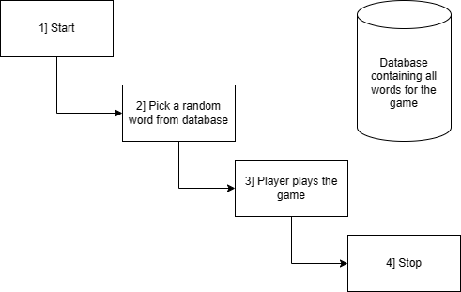
Data Flow Diagram Level 0

Slide 14
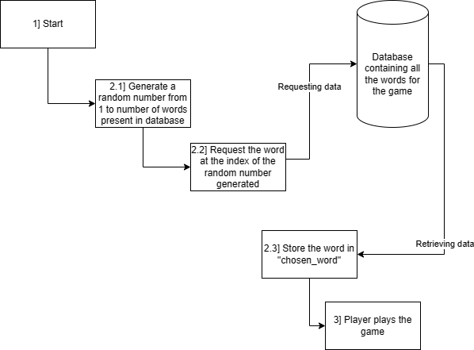
Data Flow Diagram Level 1

Slide 15
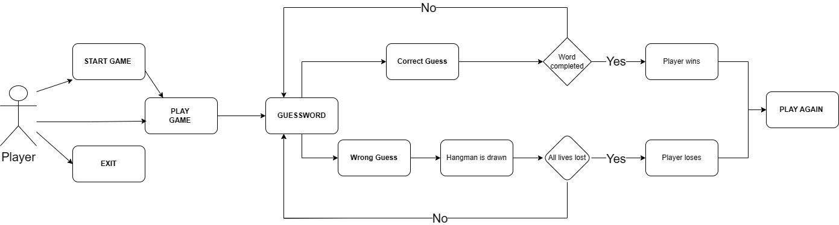
Activity Diagram

Slide 16
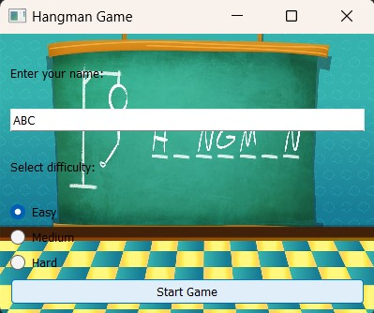
Implementation Details/ Screenshots of GUI
Start Game Screen: -
Figure 1:- This the main login screen for the game as shown in the figure 1 and it consists of your username and the selection of difficulty; Ranging from easy-medium-hard. By clicking on start you can enjoy playing the game.
Figure 1

Slide 17
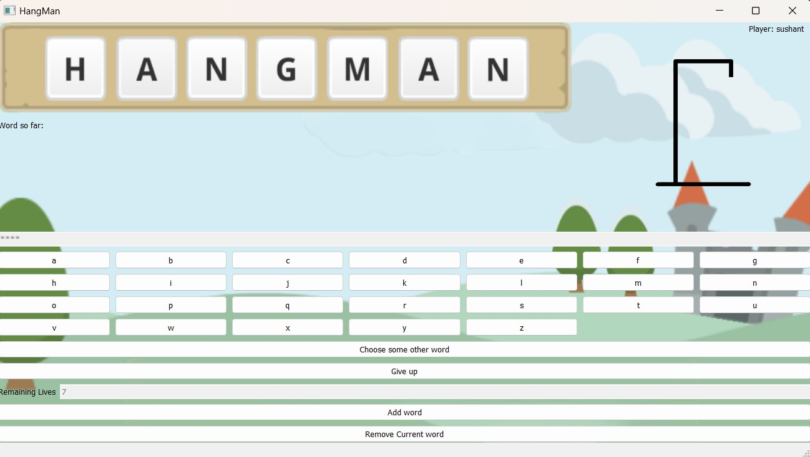
Main Game Screen: -
In figure 2: - As we can see here, we have the main screen for the game which involves our username on the right corner; and has all the letters from A-Z to guess the word to fill in the blank characters above. To the bottom-left we have a count of remaining lives to complete the game. In this interface all buttons have separate functions respectively. The Model without the stickman shown is the default state for the adaptive images based on the game state.
Figure 2

Slide 18
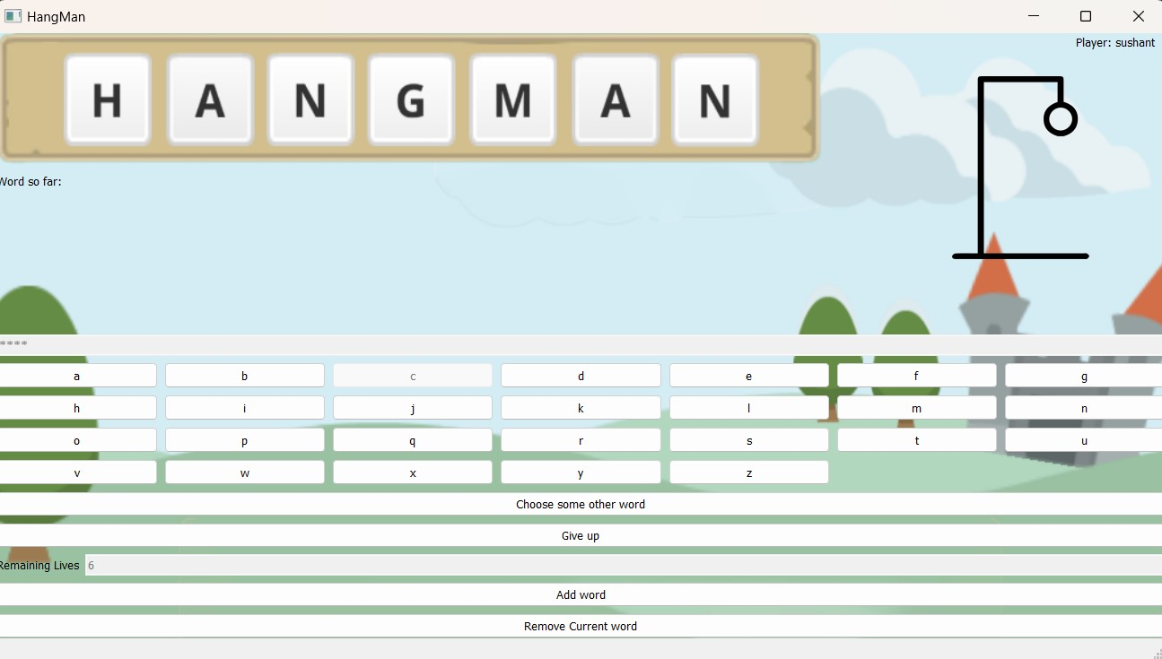
Losing Screen: -
In Figure 3:- If you select an incorrect letter here, in that case you would lose 1 life and a head would appear on the right corner of the screen.
Figure 3

Slide 19
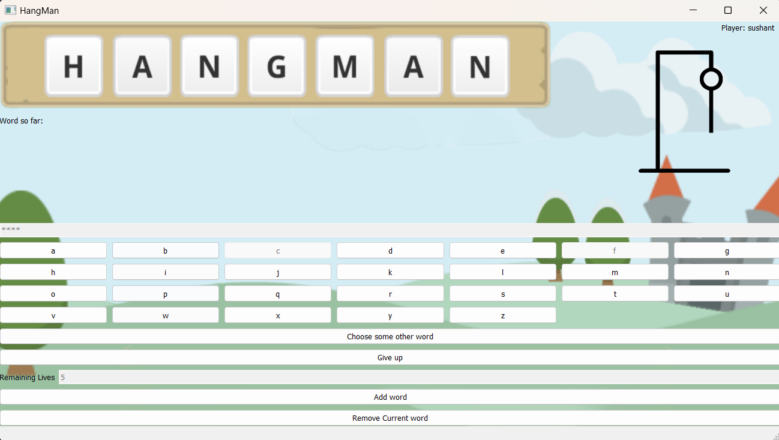
In Figure 4:- If you select 2 incorrect letters, you would lose 2 lives and head along-with body would appear.
Figure 4

Slide 20
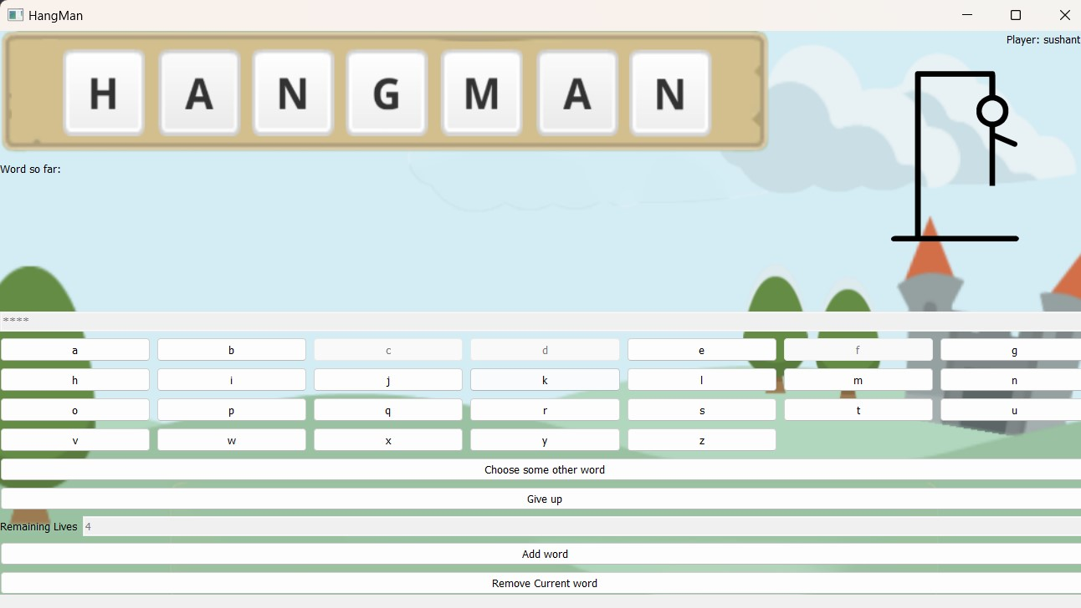
In Figure 5:- If you make 3 incorrect selection, you lose 3 lives and appearance of head-body-and a right hand would be seen.
Figure 5

Slide 21
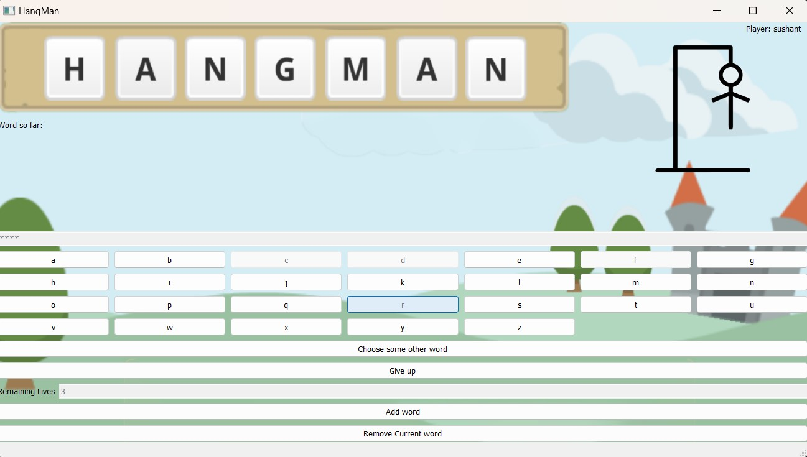
In Figure 6:- If you make 4 incorrect selection, you lose 4 lives and appearance of head-body-and both hands would be seen.
Figure 6

Slide 22
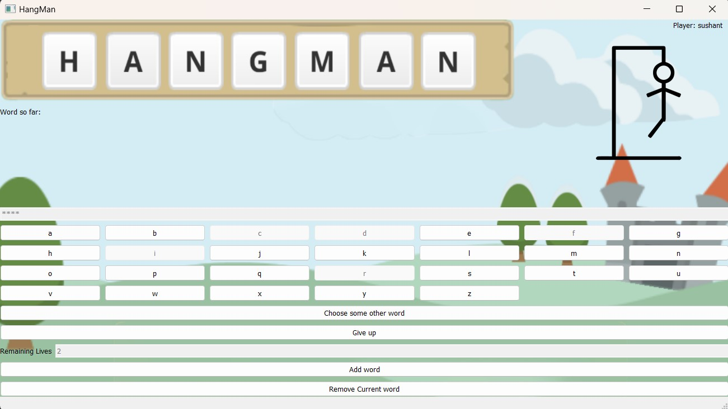
In Figure 7: - If you make 5 incorrect selections, you lose 5 lives and appearance of head-body-both hands-and a leg would be seen.
Figure 7

Slide 23
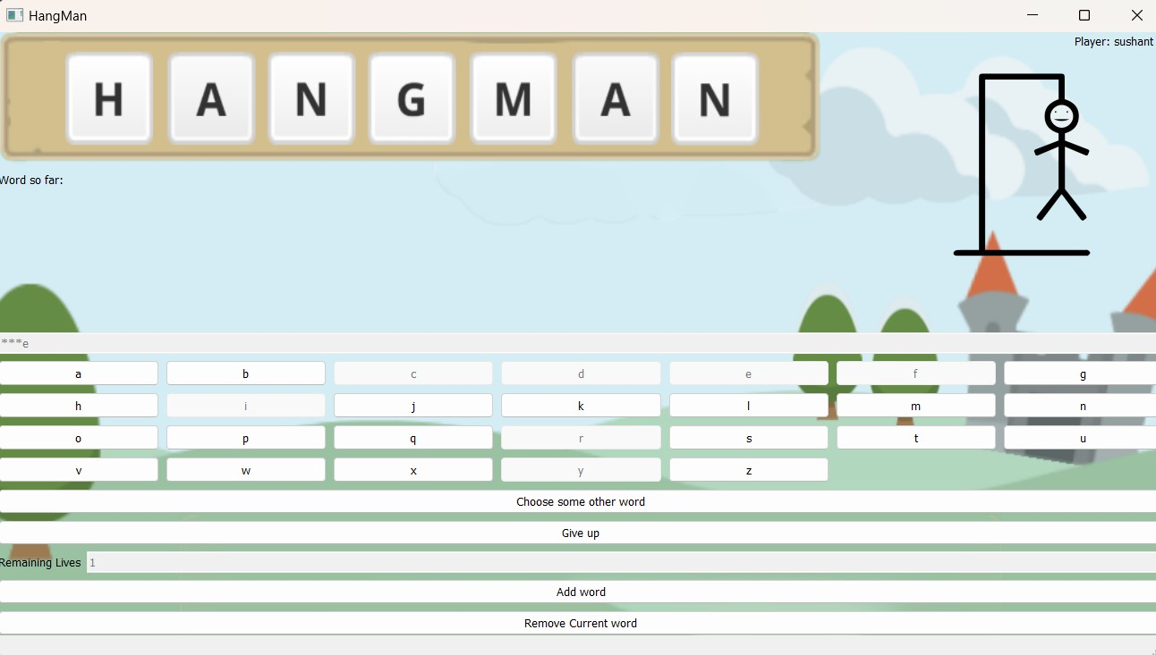
In Figure 8: - If you make 6 incorrect selections, you lose 6 lives and appearance of head-body-both hands-both legs would be seen.
Figure 8

Slide 24

In Figure 9: - If you make all letters incorrect you lose all lives making the hangman completely dead which would be seen on the top right corner, and you would be displayed the losing toast along with the answer.
Figure 9

Slide 25
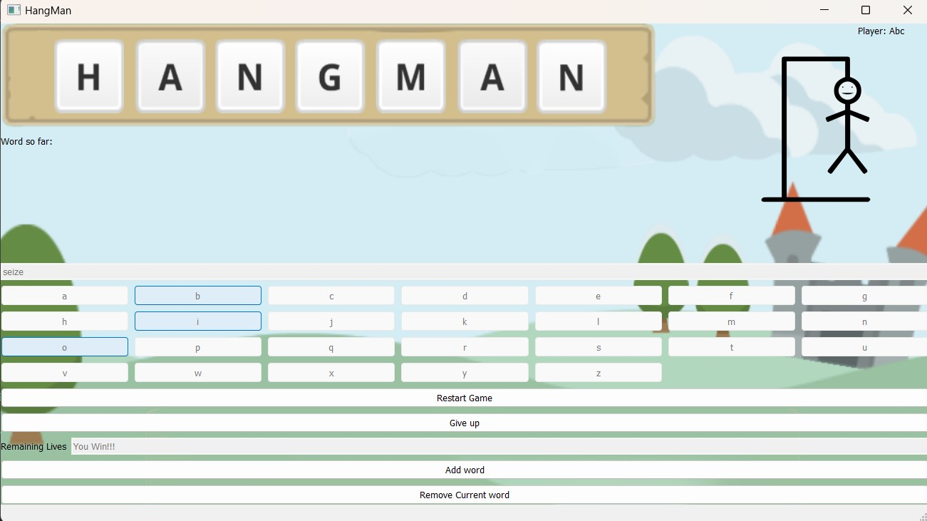
Winning Screen: -
In Figure 10: - If you guessed correctly one by one and fill in the asterisk, you won’t lose any lives and be able to see the word. The count of lives will be changed to – “You Won!!!”.
Figure 10

Slide 26
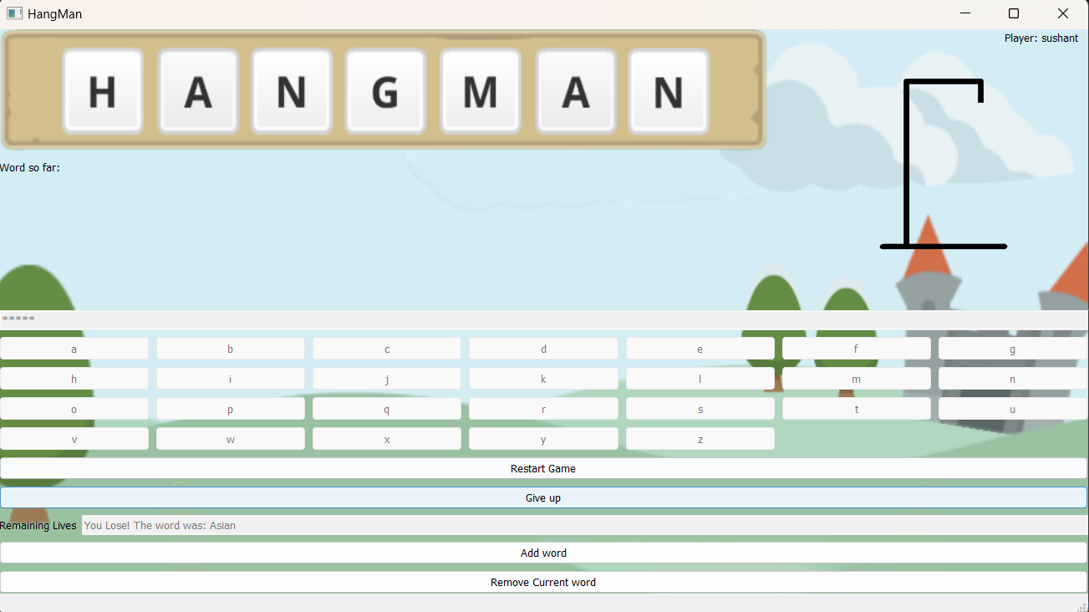
Give Up: -
In Figure 11: - If you click on the give up option you loose and you would be displayed the word on the option of life count along with “you lose” statement.
Figure 11

Slide 27
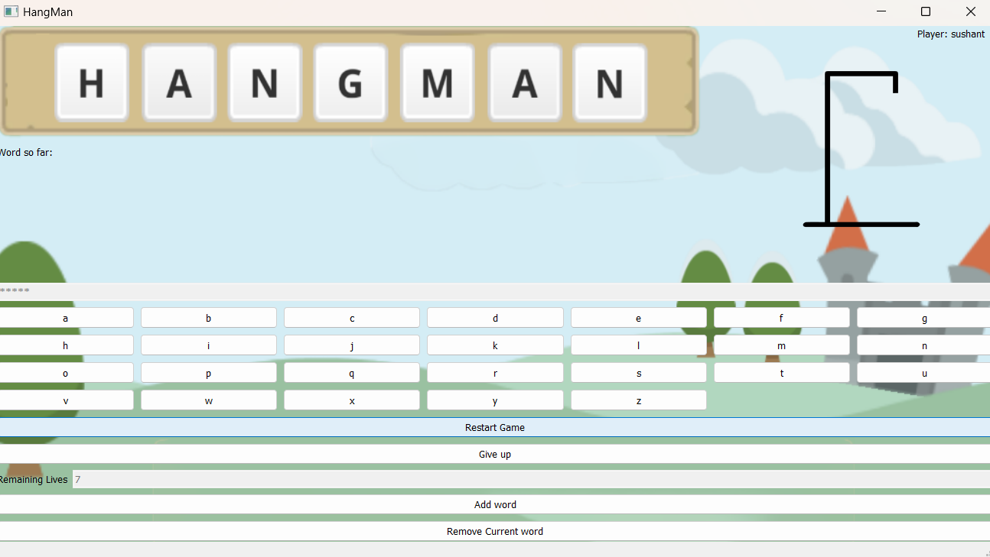
Restart Game: -
In Figure 12: - When you click on restart game you would see that the game begins again from the beginning and there would be a new word to guess with resetting the life count and the hangman animation.
Figure 12

Slide 28
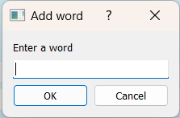
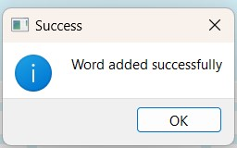
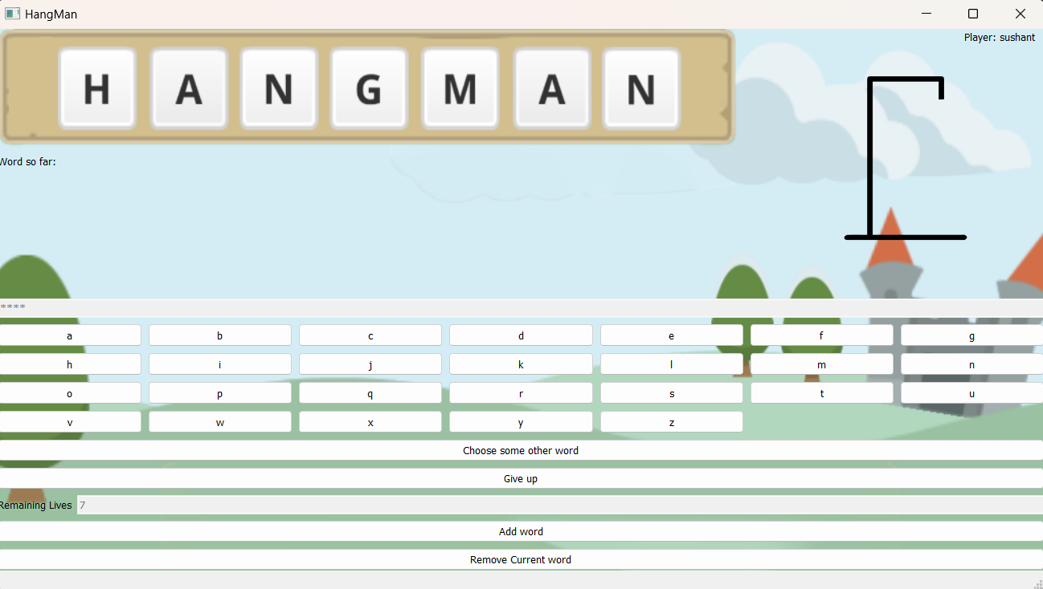
Add Word: -
Figure 14
Figure 15
In the above Figures: - In figure 13 if you click on the option add the word you get a pop-up as shown in figure 14 to add an additional work. After you add the word into the database you see the pop-up of success as indicated in Figure 15.
Figure 13

Slide 29
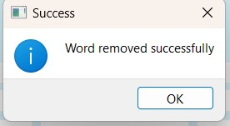
Remove Word: -
Figure 17
In above Figures: - In figure 16 if you click on “remove current word” option it will remove the current word from the database with the pop-up displaying it (as shown in figure 17) and the game will restart with new lives and new word to guess.
Figure 16

Slide 30
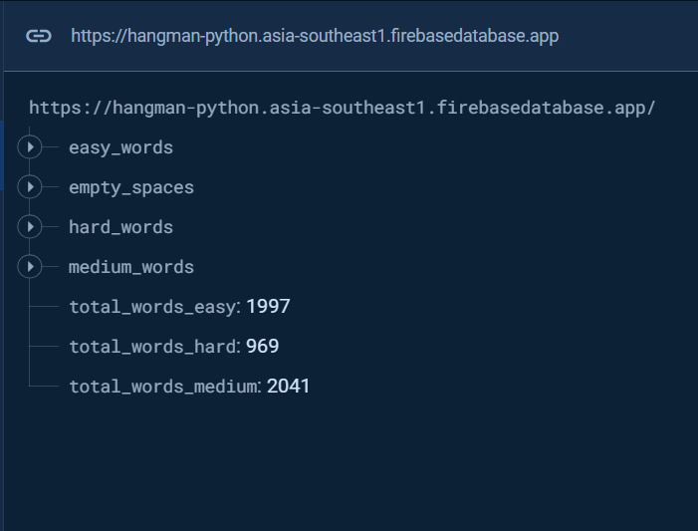
Database
In Figure 18: - This is the complete structure of Database of Hangman Game which is made in Firebase Realtime Database. Firebase Realtime Database is a NoSQL database that stores data as JSON objects. Unlike relational databases, Firebase Realtime Database does not use tables with rows and columns. Instead, it uses a hierarchical structure of keys and values..
Figure 18

Slide 31
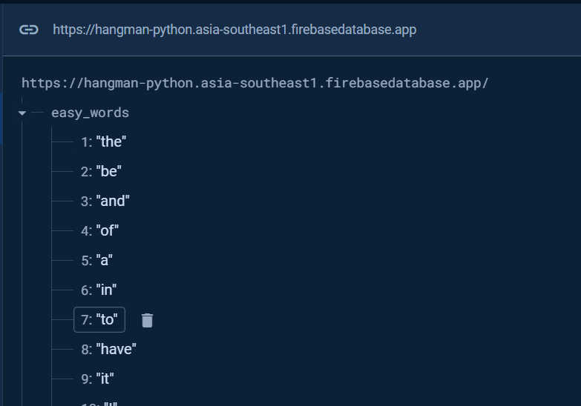
In Figure 19: - easy_words contains words that are used by the easy difficulty option in the game, it consist of all the words that are 5 letters or less.
Figure 19

Slide 32
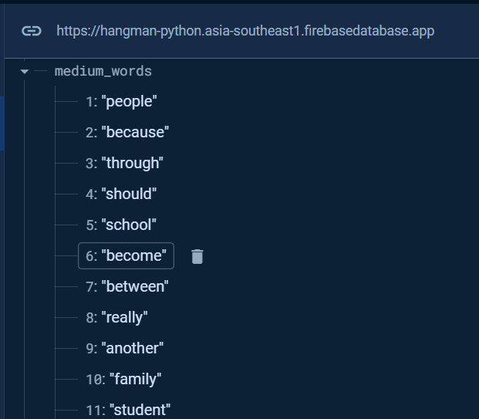
In Figure 20: - medium_words contains words that are used by the medium difficulty option in the game, it consist of all the words that are 5 to 8 letters in length.
Figure 20

Slide 33
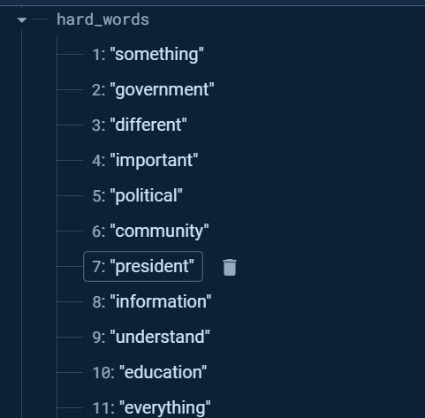
In Figure 21: - hard_words contains words that are used by the hard difficulty option in the game, it consist of all the words that are 9 letters or more.
Figure 21

Slide 34
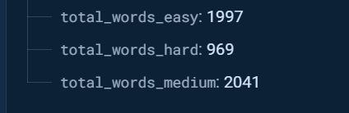
In Figure 22: - Total_words keeps the respective count of the words currently in the list, it is separated by the different stacks we are using for the words. This count is used to determine a random word for the game.
Figure 22

Slide 35
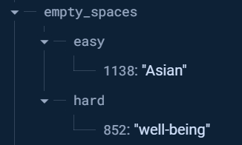
In Figure 23: - empty_spaces keeps a track of all the words and index values that were removed using the remove word feature in the application. It segregates itself based on which word was removed from which specific difficulty.
Figure 23

Slide 36
References
Chatgpt: Helped in bug fixing along with some help for developing new ideas.
Stackoverflow: Used in solving bugs and getting methods to solve certain issues.
Youtube: Helped in getting new ideas for the project and ways to implement them.
Geekforgeeks: Wording for creating documentation and ppt
Google: Helped in info for parts of ppt and documentation along with random bug fixes.
The Github Repository of this Project with the Source code, Project Report and a copy of this PPT can be found at: Armaan4477/Hangman: Python sem 4 mini project (github.com)

Slide 37
Thank You!!!

